Slide 1
Hello and thank you for facilitating an informational session. This template is fully intended for you to update and personalize to meet your needs and the needs of potential candidates.

Slide 2


Welcome!
National Board Certification Information Session
Cyntha Slavish, NBCT
Generalist, Middle Childhood
Notes:
Thank you so much Peggy and Jeff. You two are amazing!
I’m so glad each of you is here!
I invite you to put your school or district, the area you teach, and what you’re most curious about National Board certification in the chat.
Later in the presentation you’ll be doing a self assessment, so you may want to grab a small piece of paper and pencil or a way to record your thoughts.
Also, if you have questions as we go along, please put them in the chat.
The National Board for Professional Teaching Standards is a completely teacher driven organization. Practicing and retired teachers serve on the Board of Directors and as staff. Teachers developed both the standards and assessments. Teachers score candidate entries. Currently Cathy Anderson, from Eau Claire, serves on the board of directors for the NBPTS as does Shelly Moore Krajacik who is from WI and the NEA representative and also on the board of directors so WI is well represented on the NB Board of Directors!
You’ll hear me say by teachers, for teachers!

Slide 3


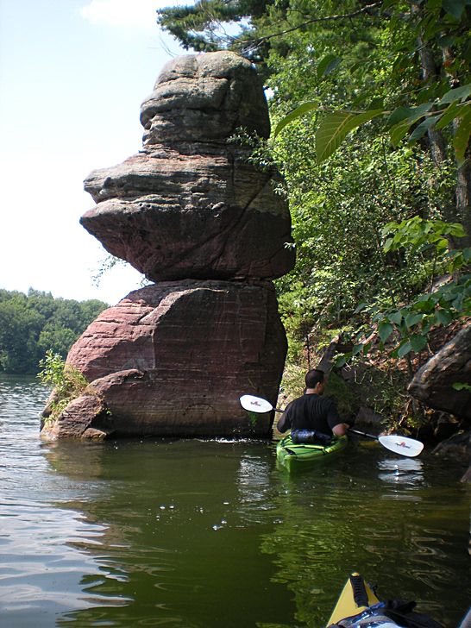
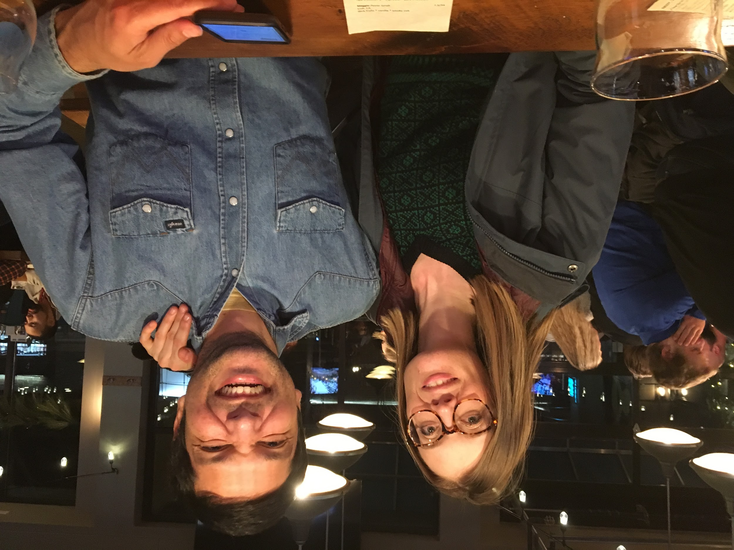
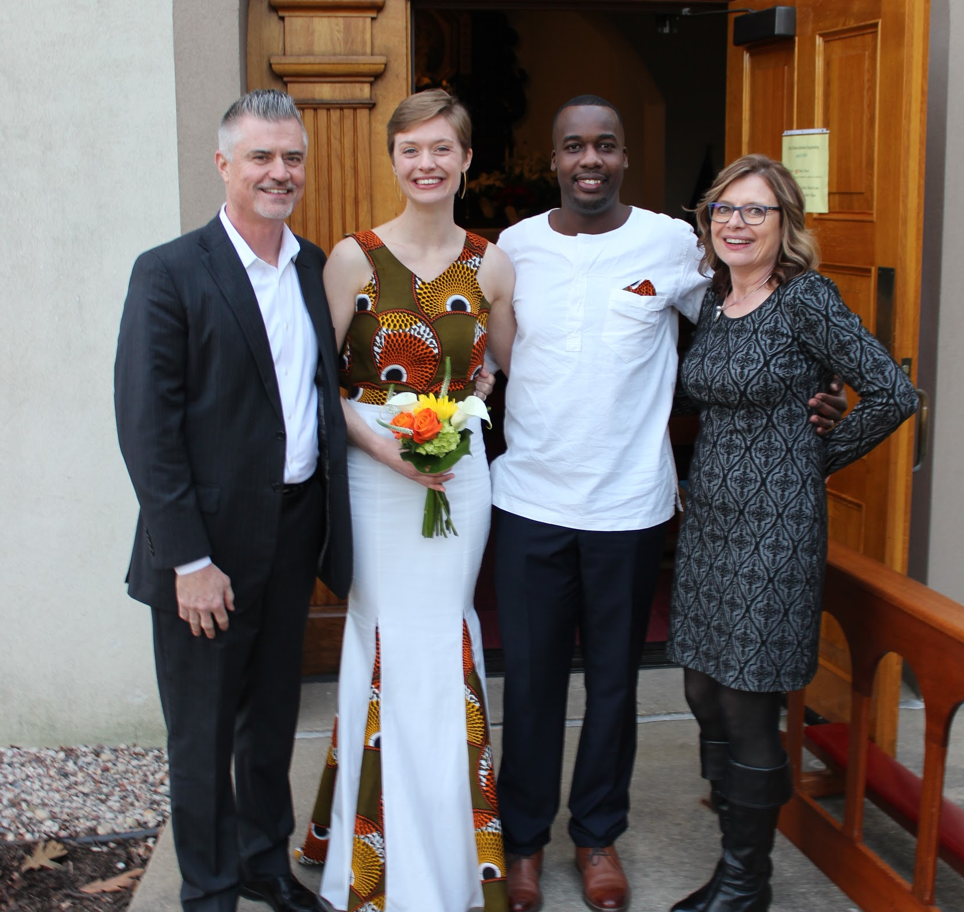
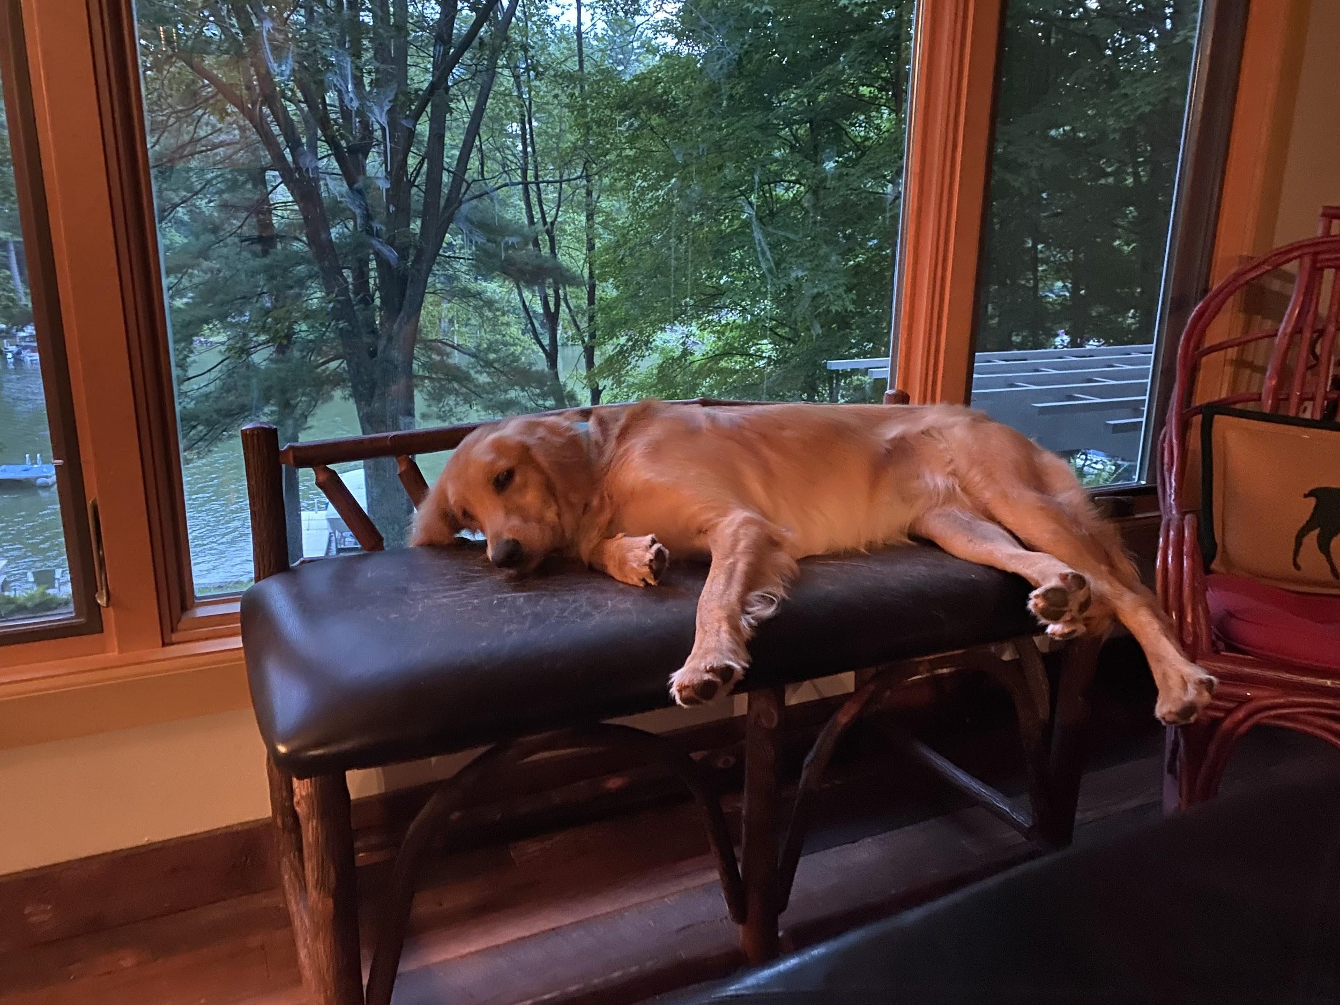
School District of
BELOIT
thinkingbeyondnow
Notes:
A little about me
Generalist, Middle Childhood Certified in 2005 and Renewed in 2015; Taught 1st-6th grades in rural, suburban, parochial, and urban districts in Illinois, Texas, and Wisconsin and stayed at home for six years with our two daughters and I taught one of our daughters two years in a row when I looped with a first grade class to second grade.
Literacy Coach/Reading Specialist, School District of Beloit (Region 6) for the last ten years
Candidate Support Provider through Region 6/MTI; Secretary Wisconsin National Board Network; WEAC NB mentor
Mother of two strong adult women who are extraordinary and who are my hope for the future!
Wife to a huge Illiniois fan
Daughter of an ag teacher and RN who devoted their careers to public service.
Dog-owner to a loving Golden Retriever, Harley
Outdoor lover especially of National Parks and Lake Redstone near Reedsburg
I’m trying to figure out how to restructure my life in a couple years when I retire. I hope that will still involve mentoring and supporting candidates as it is the most meaningful work I do! I honestly do not think I would still be in education if I couldn’t do this sustaining work!

Slide 4
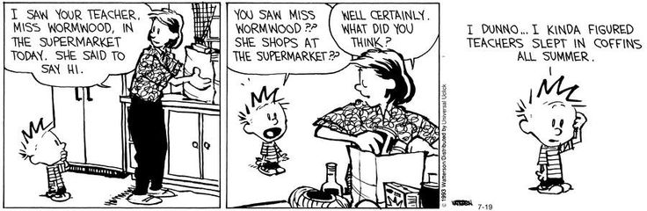
Notes:
Doesn’t summer seem like ancient history?
Thank you, thank you for attending and for being curious about this process.
Chances are you’ve talked with a colleague who has gone through this process, and you’re here to find out more about National Board Certification.
Maybe you’ve heard about the money or the fame that national board certification can bring you, and you strongly desire to reap the benefits. I’m still waiting for my NFL salary and a walk on the red carpet!
Perhaps you want to determine your own professional development and you are looking for ways to spend your time analyzing the accomplished work you do.
Or maybe like me you want to prove something to the outside world that teaching is a highly respected profession, and we deserve to celebrate that!
Perhaps someone told you that you weren’t a very good teacher and you’re out to prove otherwise.
Maybe a certified teacher tapped you on the shoulder and said, “Hey, look into this!”
Just as there are as many reasons people begin this process, there are equally as many ways to certify. Just know that our union and other NBCTs in WI are here to support you on this journey so that you don’t have to sleep alone in a coffin all summer!

Slide 5
NBPTS’ Mission
Maintain high standards for what teachers should know and be able to do.
Provide a voluntary system of certifying.
Advocate for education reforms tapping into the expertise of National Board Certified Teachers (NBCTs).
“A process by teachers for teachers.”
Notes:
I’ll let you read the National Board of Certified Teachers’ Mission
AFT president Al Shanker was the first to call for a national standards board in a speech to the Press Club in 1985 during the early era of A Nation at Risk’s detriment to our profession.
Certification is created by teachers for teachers and completely voluntary.
NBCTs, collectively are known as a competent group of professionals whose voices are at the forefront of ed reform and policy at local, state and national levels.

Slide 6
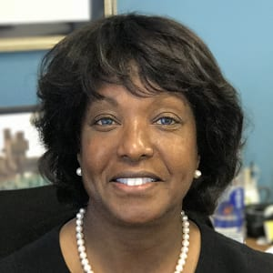
Peggy Brookins, NBCT, President and CEO of NBPTS
Notes:
Peggy has been the CEO since 2015. You’ll see her on some webinars as she often joins the NB staff to welcome webinar participants. President Barack Obama named Brookins as a member of the President’s Advisory Commission on Educational Excellence for African Americans.
Ms. Brookins predecessor, the late Ron Thorpe, former CEO/Director of the National Board Process said:
“There is consensus that teacher quality is the most important school-based variable determining how well a child learns. It explains why all Americans should care about what it will take to create and sustain a teaching workforce defined by accomplished practice.”

Slide 7
Session Objectives
Describe the professional and financial benefits of National Board Certification.
Outline the process for becoming certified.
Determine your personal next steps.
Notes:
At the end of the session I hope you will have a better understanding of what the benefits are of NB Certification and that you have a cursory understanding of the first layers of the process for becoming certified. Finally, I hope you know what supports are available for you to take your next steps by registering as a candidate.
We’d like you to leave this presentation with a decision to become a candidate.
If you decide to pursue National Board Certification, we hope you leave with a personal action plan. As a WEAC member you may attend cohort support sessions throughout the state. In addition, WEAC offers three hours with a personal WEAC mentor. Later I’ll mention a couple of other statewide supports WEAC offers.

Slide 8
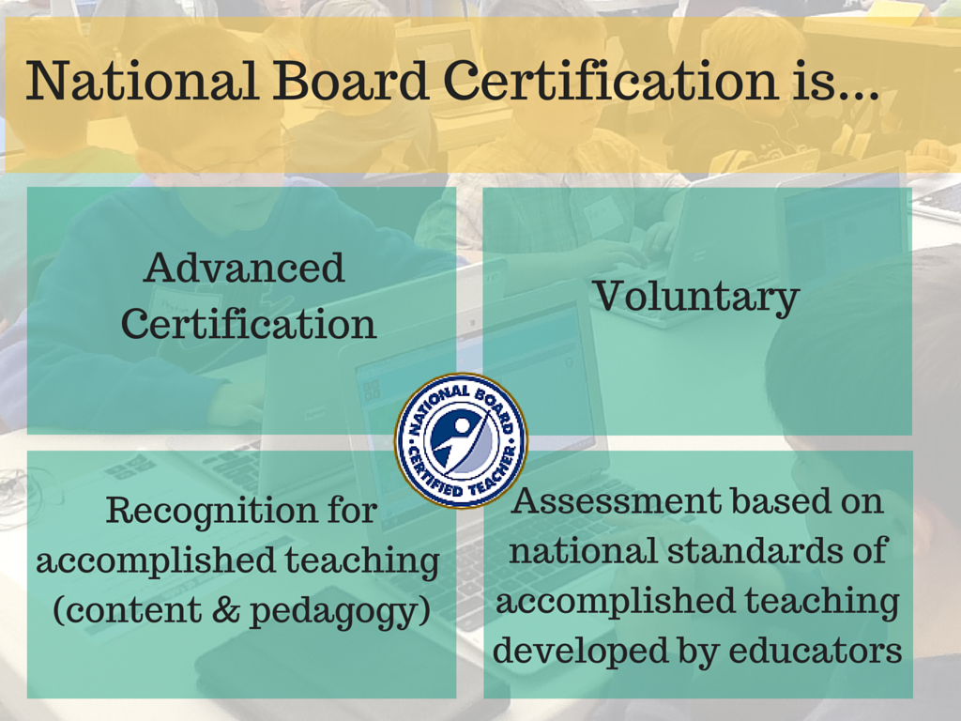
Notes:
NB Certification is an advanced certification and at the end of the continuum for teaching.
Again, created by teachers for teachers. It’s a demonstration of your content and pedagogical knowledge and expertise with assessment developed not by outsiders but by fellow educators.
Securing National Board Certification is also a way that members can give themselves a raise.

Slide 9
Significant Body of Research
Closing the Achievement Gap
Students of NBCTs experienced year-end testing improvements that averaged 7 to 15 percent more than peers whose teachers did not hold the certification. This performance differential was most pronounced for younger and lower-income students whose gains were as high as 15 percent. (University of Washington and the Urban Institute, 2004)
Student Achievement Gains
Students of NBCTs outperformed students of non-board certified teachers on the Stanford-9 Achievement Test, with learning gains equivalent on average to spending more than an extra month in school each year. (Arizona State University, 2004)
Notes:
Research indicates younger students whose families fall on the lower-income side make as high as 15 % gains with an NBCT and students of NBCTs outperformed students of non-board certified teachers on the Stanford-9 Achievement Test, with learning gains equivalent on average to spending more than an extra month in school each year. (Arizona State University, 2004)
One of my dear friends and National Board Colleagues, Sandra Michels from Green Bay, is currently obtaining her PhD and she is analyzing data to gain insight into what more of the effects of having a board certified teacher are.

Slide 10
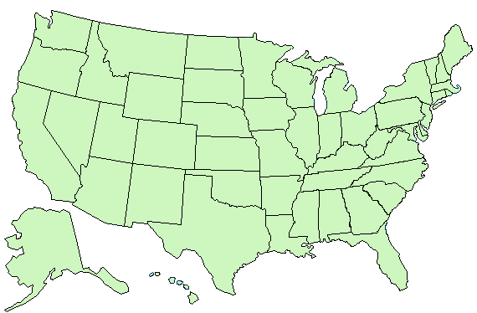
Where are NBCTs?
_{WA}
₇₂₅₆
_{NH}
₂₁
_{MT}
₁₃₈
_{VT}
₂₃₆
_{ME}
₂₅₄
_{ND}
₄₁
_{OR}
₂₉₆
_{MN}
₃₉₂
_{ID}
₃₇₄
_{NY}
₁₆₀₃
_{MA 596}
_{SD}
₁₀₃
_{WI}
₁₀₁₅
_{WY}
₄₉₇
_{MI}
₃₈₅
_{RI 490}
_{IA}
₆₈₃
_{PA}
₁₁₄₂
_{CT 151}
_{Guam – 2}
_{Virgin Islands – 1}
_{Armed Forces – 22}
_{Foreign Addresses - 51}
_{NV}
₅₈₆
_{NE}
₁₁₀
_{OH}
₃₃₃₇
_{NJ 253}
_{UT}
₂₃₀
_{IL}
₅₈₄₂
_{IN}
₁₅₉
_{DE 452}
_{CA}
₅₉₇₅
_{CO}
₈₃₇
_{WV}
₇₄₉
_{VA}
₂₈₈₉
_{MD 2572}
_{KS}
₃₉₃
_{MO}
₈₅₆
_{DC 81}
_{KY 2979}
_{NC 20,122}
_{AZ}
₁₀₇₈
_{OK}
₃₀₇₇
_{TN 643}
_{NM}
₈₇₀
_{AR}
₂₅₆₉
_{SC}
₈₆₆₁
_{MS}
₃₅₅₇
_{AL}
₂₂₄₃
_{GA}
₂₅₉₅
_{TX}
₈₂₂
_{LA}
₁₈₆₄
_{AK}
₁₆₄
_{FL}
₁₃₆₆₉
_{HI}
₄₆₉
Notes:
Here are the numbers of NBCTs:
North Carolina, Florida, South Carolina have the largest numbers of NBCTs.
As you can guess these states offer monetary incentives for NBCTs.
WI has 1,452 NBCTs as of July 2020.

Slide 11
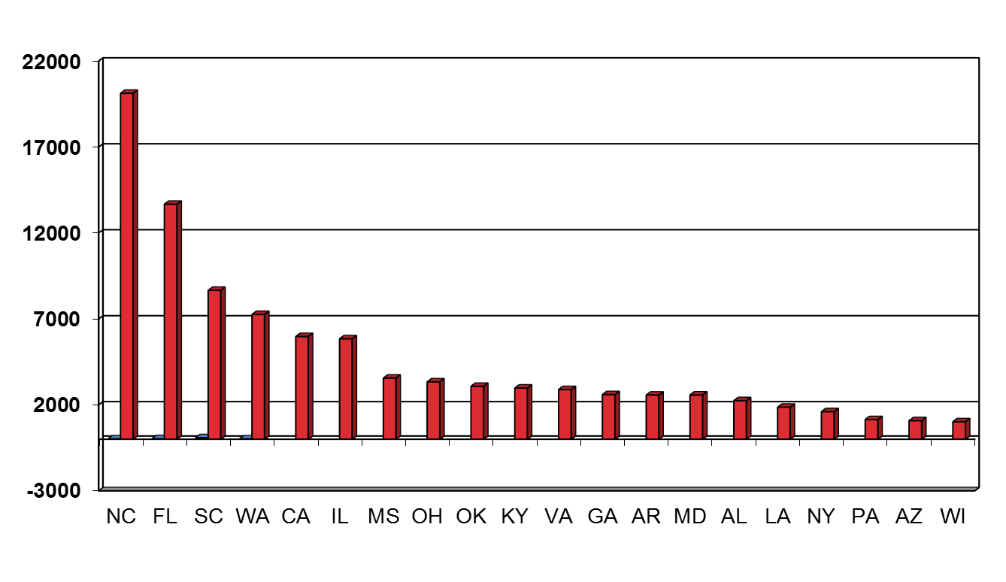
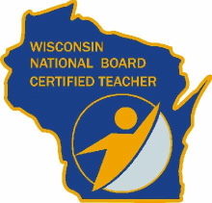
The Top 20 States
Notes:
This is another visual to show the states with the most NBCTS with Wisconsin being in the top 20.
The top right shows you an image of the pieces of swag you receive in a pinning ceremony after you certify.
In 2019 we were able to hold this pinning ceremony at the governor’s mansion and our state superintendent, Carolyn Stanford Taylor, and NEA NBCT Shelly Moore Krajacik distributed those pins. The first lady of WI, Kathy Evers and WEAC sponsored the special event.

Slide 12
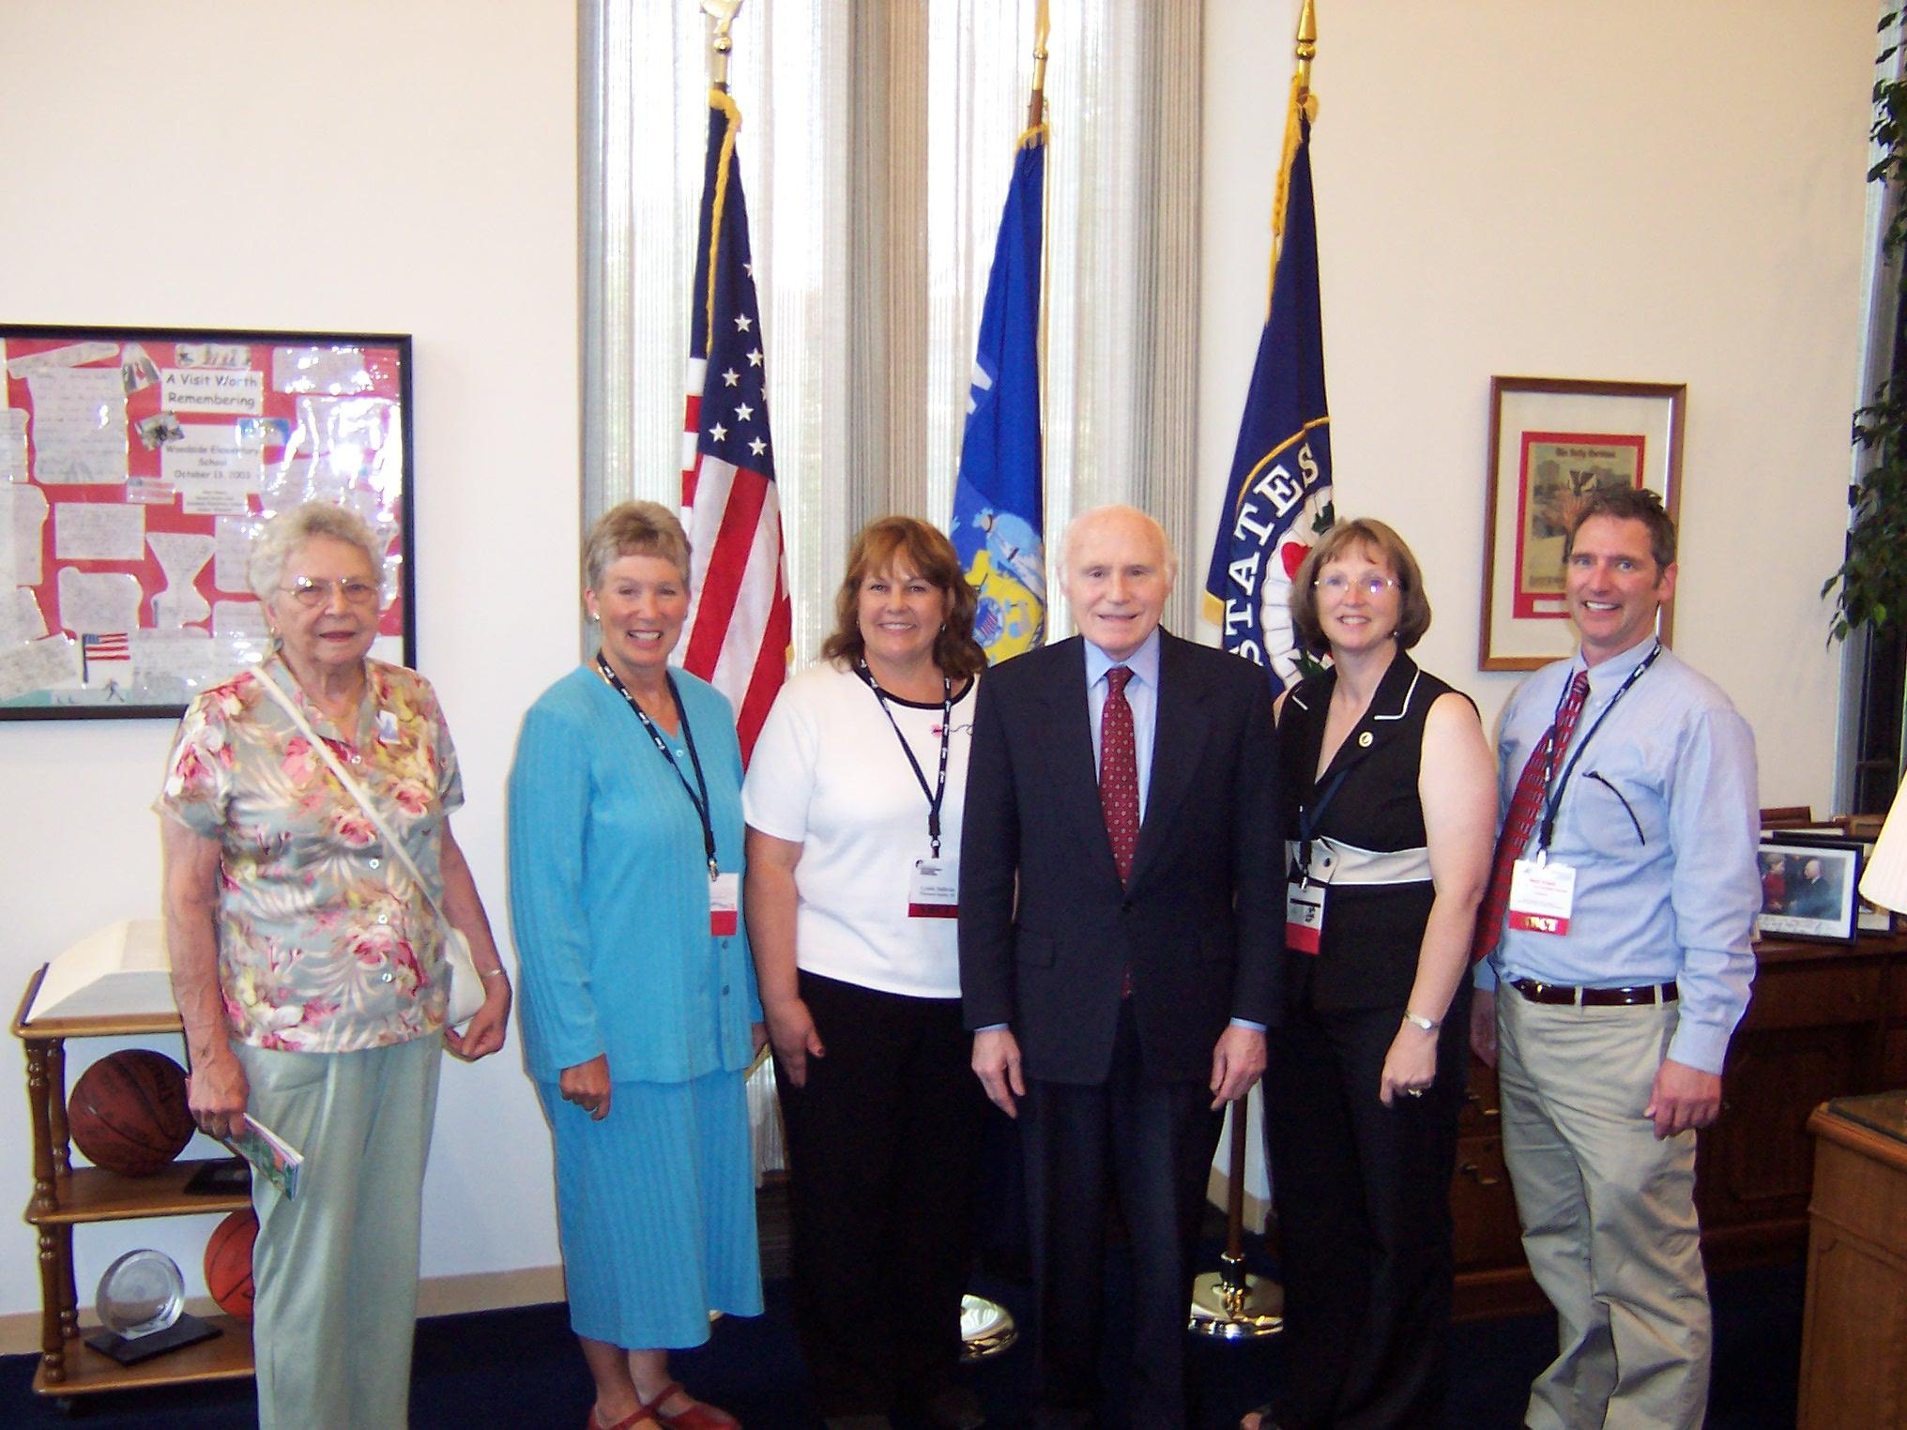
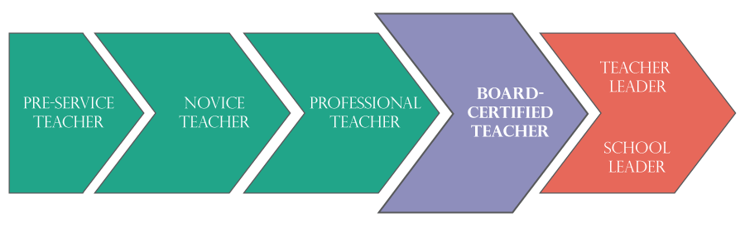
Eligibility Prerequisites
3 years of experience as a pre K-12th grade teacher or school counselor.
A bachelor’s degree from an accredited institution.
A valid, unencumbered teaching or counselor license.
Notes:
Jeff does a lot of work with all areas of this continuum. If you have recently become an educator or you’ve recently mentored a student teacher, then you are familiar with a process that has some of the same features as the National Board process. In fact teachers who have recently been pre-service and novice teachers who have gone through ED-TPA are quite familiar with the requirements for video-recording in the NB’s Component 3. Our union works to support educators in all phases of their careers.
Your experience can be in a private or public school. There tends to be a national push to encourage 3rd-4th year teachers to apply for certification, but you can start the process with three years of experience or more.
Thinking about the spectrum from pre-service to teacher leader, we have one candidate who is very close to retirement! If you have gone through EdTPA, then the NB process will look very familiar to you!

Slide 13
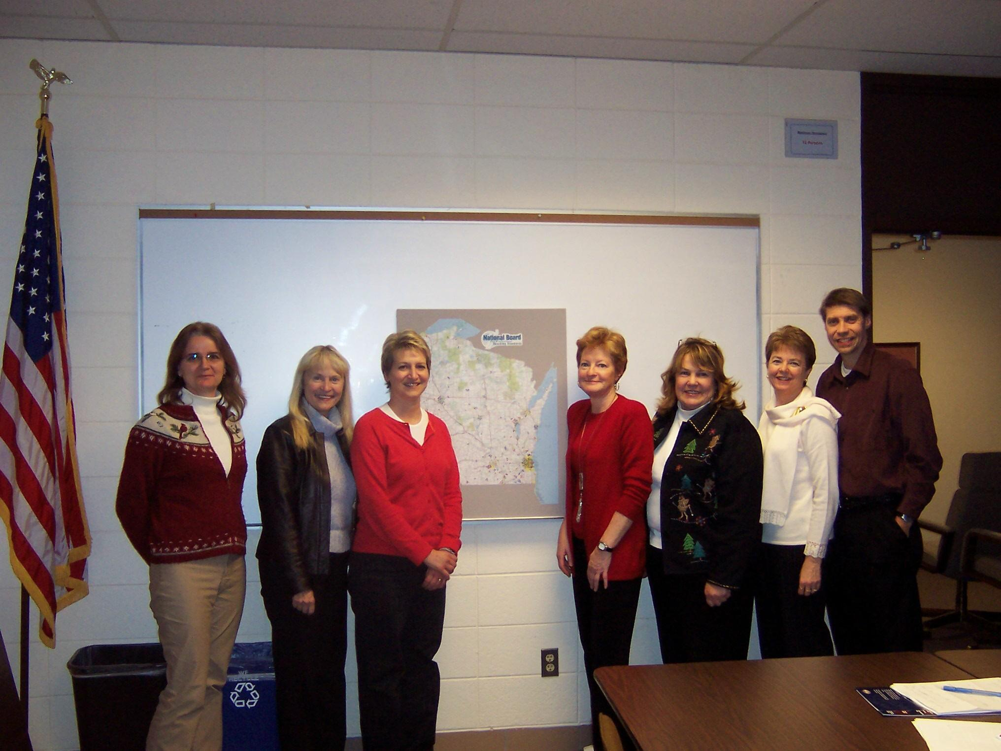
Certification Areas
AGE CATEGORIES
Early childhood
Middle childhood
Early adolescence
Young adulthood
CONTENT AREAS
Art
Career and Technical Education
English as a New Language
English Language Arts
Exceptional Needs
Generalist
Health Education
Library Media
Literacy: Reading-Language Arts
Mathematics
Music
Physical Education
School Counseling
Science
Social Studies-History
World Languages
Notes:
There are 25 Areas with the different four age categories and 16 content areas. Some of the content areas have different age ranges like the Generalists can be either early childhood or middle childhood and other certificate areas have just one age band like Exceptional Needs which ranges from birth-21. If the certificate area you are considering has different age ranges, you’ll want to look at those ranges carefully, because 51% of your class needs to fall within the age range that you selected.

Slide 14
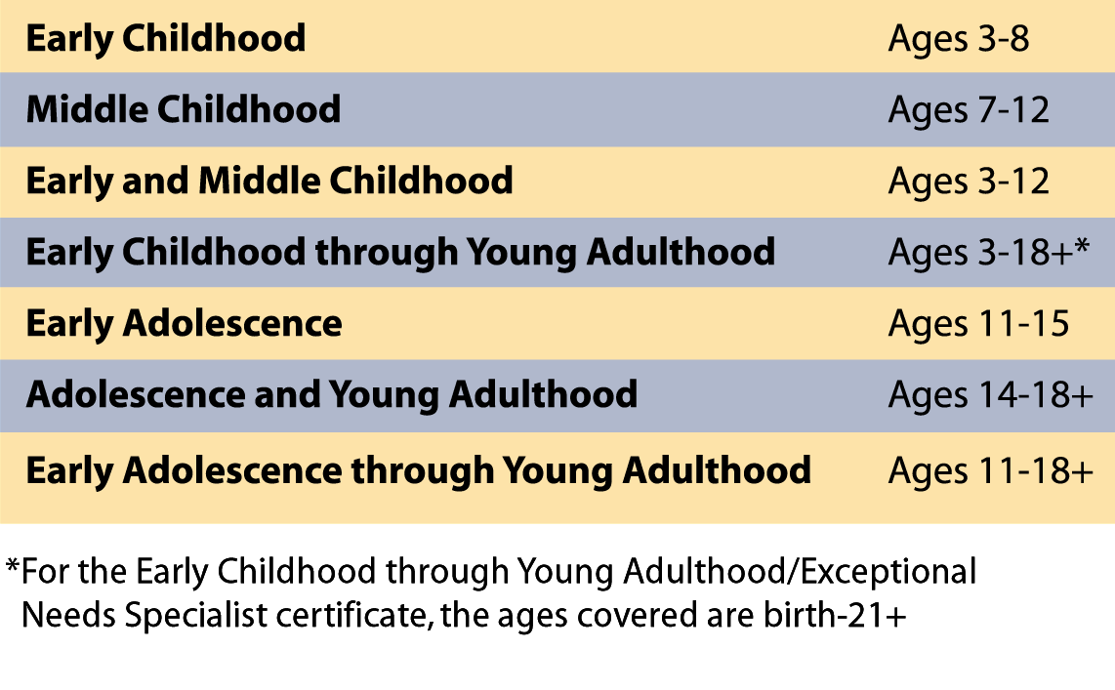
Age Categories
Notes:
These are the age ranges that I was referring to. Again it’s important to select the appropriate age category, because of the requirement that 51% of your class represents that age requirement. Remember not all certificate areas have each of these age ranges.
Jeff, please click on the slide for the National Board’s version of how they show the same thing.
This slide is linked to the website that show the areas and developmental ages.

Slide 15
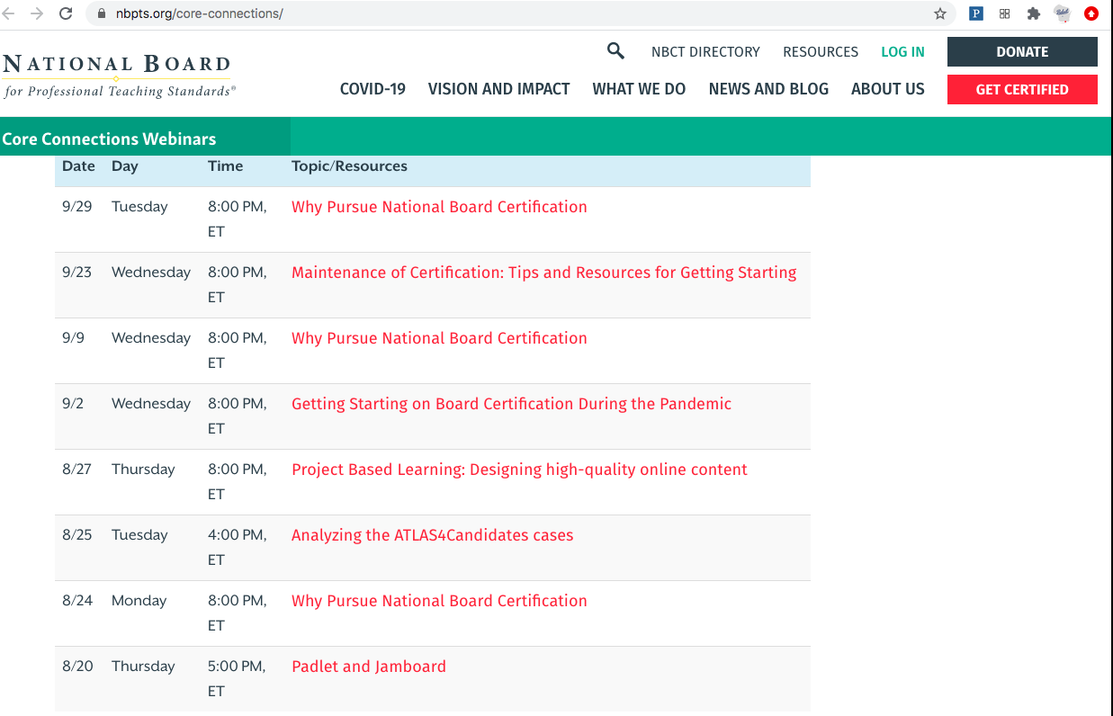
https://www.nbpts.
org/core-connections/
Notes:
The National Board has exhibited responsiveness and flexibility regarding candidates’ needs during COVID-19.
I spent the summer watching a plethora of videos available to anyone, not just teachers considering certification.
But many of the videos are related to certification, as you dig in to the layers of candidacy. They truly are the best PD that’s out there!
The website is https://www.nbpts.org/core-connections/ and it’s at the bottom right of the slide.
If you Google COVID-19 and NBPTS you’ll be led to a page with resources. There are so many resources that now it’s a multiple page document, so if you don’t see what you’re looking for on the first page, keep going….
This slide is linked to the website.

Slide 16
Benefits of Certification
Annual State Stipend
Wisconsin NBCTs receive a 10 year Master Licensure
Many school districts provide compensation to NBCTs
License portability
Have your voice heard
Glory and esteem
Notes:
There are many benefits of certification.
Wisconsin has an 10-year renewal, but now the national license is a five year license. Maintenance of Certification/MOC: renewal every five years now.
Renewal is not as involved as the original certification process.
National Board’s mission aligns directly with WEAC’s desire to promote quality teaching and learning. While the union might have the reputation of “protecting bad teachers” this is not true. This is a myth perpetuated by forces that work against us. On the contrary the union promotes accomplished teaching and National Board certification advocacy and NB support is one example of this. There are multiple free benefits as a WEAC member when it comes to supporting your NB journey.

Slide 17
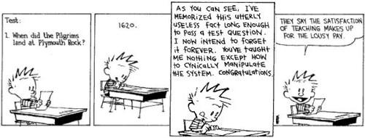
Notes:
Yes, the satisfaction of teaching makes up for the lousy pay, and the state of WI recognizes NBCTs with an annual stipend starting the second year of certification. The first year is a reimbursement of $2000. If your district doesn’t reimburse you for the fees, you can submit receipts to the state after you certify or if you’re in a district like the School District of Beloit where they do offer reimbursement for components, you can submit receipts for expenses. For example, if you attend one of WEAC’s writing retreats or the Jump Start preparation sessions or you traveled any distance to go to in person cohorts you can submit those receipts the first year you certify.
Years 2-5 of your certification include a yearly stipend for $2500 or $5000 if you’re in a high poverty school, and you have to fill out paperwork each year to receive the stipend and the initial reimbursement.

Slide 18
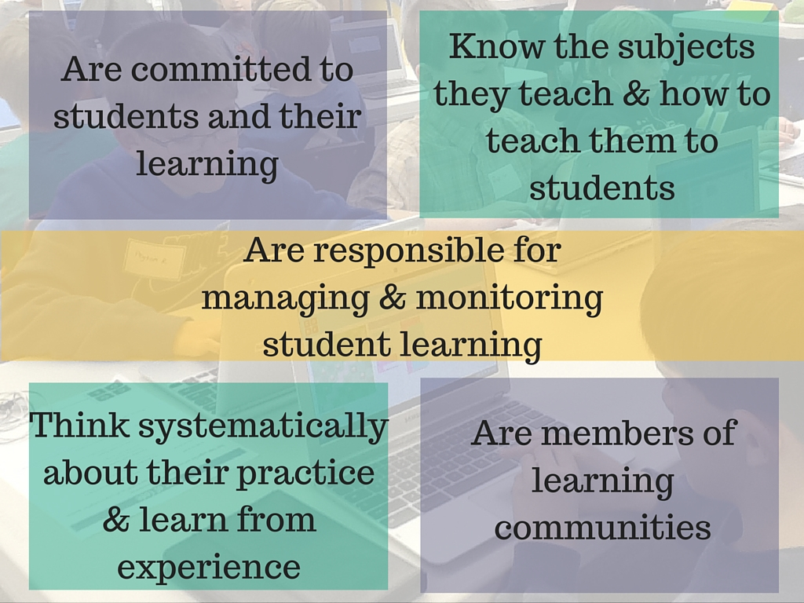
Accomplished teachers . . .
Notes:
These are the Five Core Propositions, which you will find as the basis for all the NB standards in your certificate area. This is available in a free PDF booklet that you can download from the NB website. Reading the long version of the Five Core Propositions is a great place to start your certification journey! These five core propositions are one of the four pieces of the Body of Knowledge that National Board provides for accomplished teaching.
Others include your certificate area standards, the Architecture of Accomplished Teaching and ATLAS. WEAC members have access to free candidate support as part of their membership dues! We discuss this Body of Knowledge in our first cohort sessions.
Jeff, the slide is linked to the first of the Five Core Propositions and at the top right there is a short video .

Slide 19
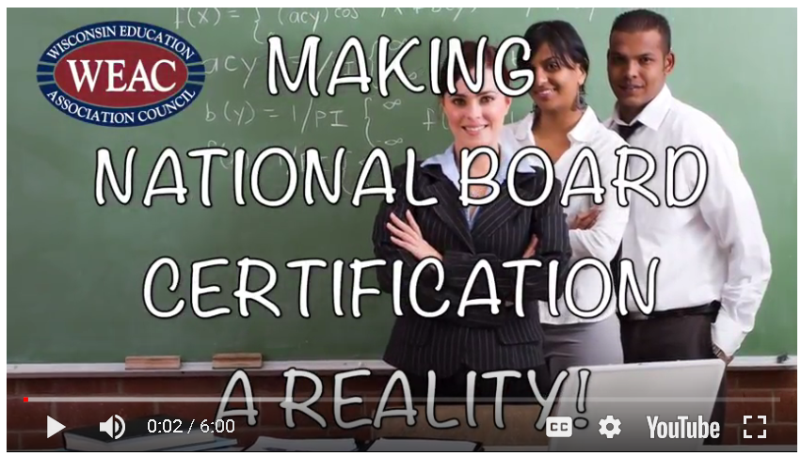
A Word from your WEAC Colleagues . . .
hhttps://youtu.be/W7d8BoBL6wg
Notes:
(Click on the top to start the informational video.)
Now here are some words from your fellow WI educators.
One WI NBCT, Nick Sirek and his mother certified together and she did so just prior to retirement!
19

Slide 20
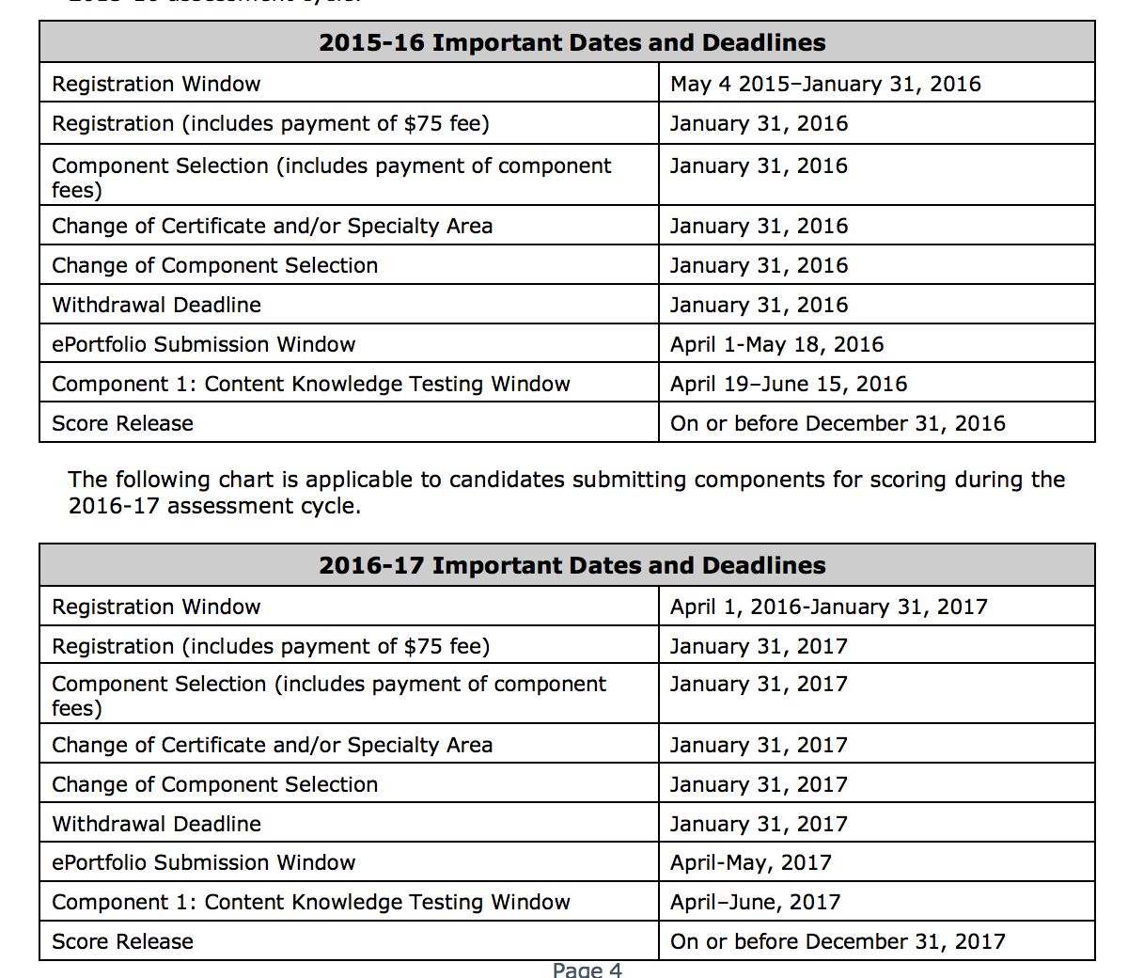
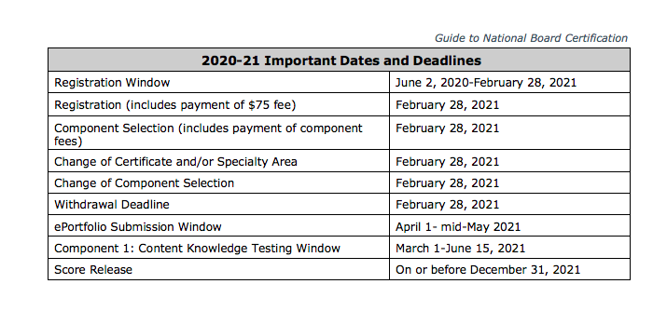
Timeline
Registration: Now-February 28
Payment due: February 28
Submission window: April 1-mid May
Testing window: March 1-June 15
Notes:
And now for some of the logistics:
I would encourage you to look at the COVID-19 page on the website to look for updates.
The Guide to NB Certification is the name of document that the dates came from and I’ll point out in a few slides that this is one of first places you’ll want to start with your reading of information for your journey!
20

Slide 21
What Do I Have to Do?
Component | Task | Evidence
1 | Content Knowledge | Assessment Center
2 | Differentiation in Instruction | Student Work
3 | Teaching Practice and Learning Environment | Videos
4 | Effective and Reflective Practitioner | Portfolio Entry
Notes:
All National Board work is grounded in the 5 propositions, the Architecture of Accomplished Teaching and your content area standards. The four components you will complete are the explication of the Five Core Propositions. If you were to summarize each of the four components in all 25 certification areas they would include
C1 is an assessment of your content and pedagogical knowledge
C2 involves analyzing student work to show how you differentiate for students’ needs.
C3 uses videos to demonstrate your effective teaching strategies, engagement of students and the positive climate you’ve established in your room
And C4 is your ability to use data that drives your decisions that drives decisions about student needs and your own professional needs
21

Slide 22
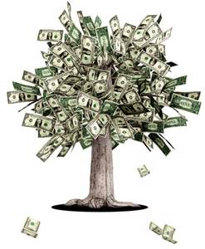
What will this cost me?
Each component is $475.
There is a $75 annual registration fee.
1 year | 2 years | 3 years
$1975 | $2050 | $2125
Notes:
You have three years to submit all four components and five total years to redo the components. Each component can be redone two different times and Component 1, the assessment center, candidates can retake the entire component or just parts of it can be retaken--one of the three constructed response or the entire selected response portion.
If you do all four components in one year, the cost is $1975. Since you pay $75 per year, if you take two years to complete the process it will cost $2050 and three years will be $2125.
22

Slide 23
Personal Readiness Assessment
I am committed to my students and their learning
I am a reflective teacher who learns from experience
I know my students: where they are and where they need to be
I set high, worthwhile goals for my students
I know my content well and how to teach it
I am a member of a professional learning community with a desire to continuously learn and grow
I have supports in place in my personal life to pursue National Board Certification & time to do it
Notes:
Here is where you need your scrap paper and writing utensil. This is for your own personal assessment.
The purpose of this slide is to have you consider your own readiness for candidacy. With the exception of the last question all self-assessment questions have been built from the Architecture of Accomplished Teaching--one of the four parts of the Body of Knowledge that I referred to earlier and that you’ll get to know.
Jot own a number on a scale of 1-10. This activity is for your own personal use only and will not be shared with the whole group. Be brutally honest with yourself. So the scale is: 1 is this isn’t me at all and 10 is I’ve got this!
(Read each statement aloud!)
Afterwards:
There’s no formal scoring or anything involved. But, you may wish to say that if you did not score yourself 8s, 9s and 10s this may not be the right time for you to pursue candidacy. If you scored many 9s and 10s you might consider taking next steps as outlined on the next slide.
23

Slide 24
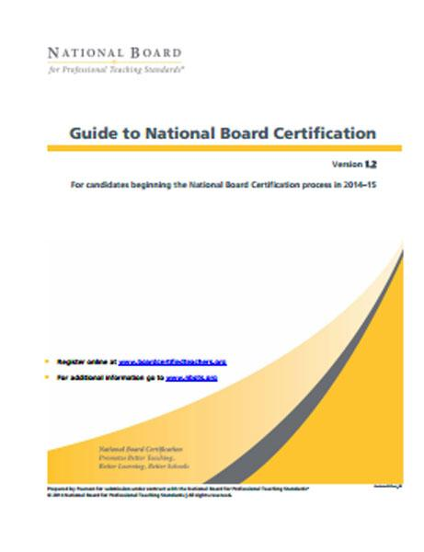
Next Steps
Read Guide to NB Certification
Read and review your Standards
Boardcertifiedteachers.org
Create an account with National Board
Pay annual $75 registration fee
Register for 1 or more components
Consider recruiting a colleague/partner
Find a support network
Notes:
So if this extremely rewarding process of certification by teachers, for teachers seems like something you want to find out more about there are a few steps you can take.
First, as I mentioned earlier, read the Guide to NB Certification (the image is linked). It’s an overview for all certification areas.
I want to clarify the fact that NBPTS has specific standards for each certification area – candidates often assume NBCTs or others are referring to content standards, WI teaching or Common Core State Standards when saying standards rather than the NBPTS standards. I mentioned earlier that the standards are specific to your certification area and are one of the four pieces of the Body of Knowledge that the National Board provides as guidance for all certificate areas. Find the standards for your certificate area.So read the Guide to NB certification, read your certificate area standards, see yourself in the Five Core propositions, create an account, register for a component, recruit a colleague and find a support network!
24

Slide 25
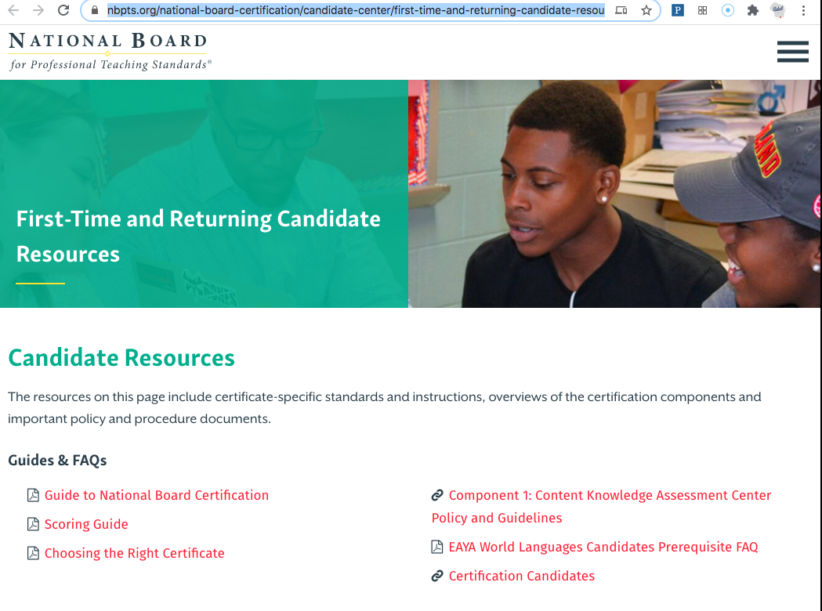
Where to Find the Standards

Slide 26
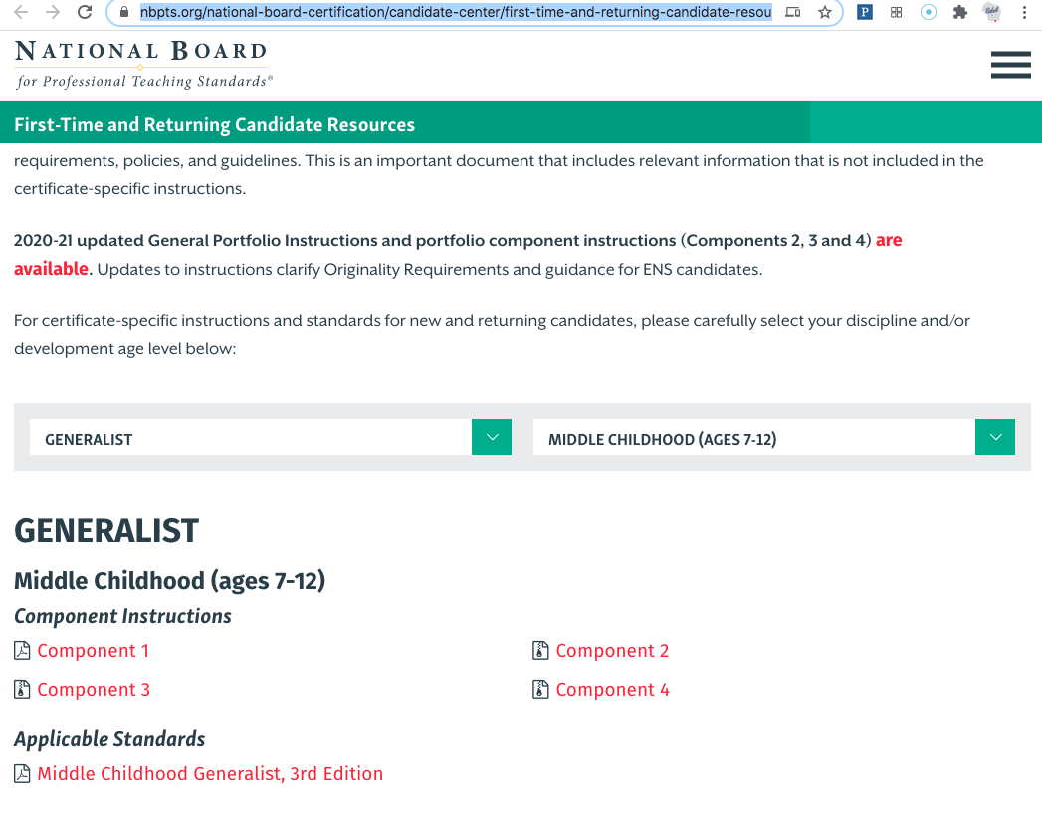
Notes:
On the Candidate Resources page, scroll down to where you put in your discipline and age category. At the very bottom it will say Applicable Standards.

Slide 27

http://accomplishedteacher.org/
Notes:
After you read The Guide to National Board Certification I would suggest you read
What Teachers Should Know and Be Able to Do or The Five Core Propositions.
accomplishedteacher.org/
This is the Five Core Propositions or the Green book or the What book. Download it and read it and see in yourself what you already do in these propositions. Seeing the positive things in yourself sets you up to do those four components.

Slide 28
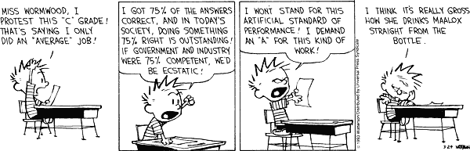
Notes:
I’m not going to lie to you. You might drink a lot of Maalox during this process.
My journey was very different than most people’s! I was extremely discreet about my process. In 2004 there was only one other NB certified teacher at BMHS. I have some perfectionistic tendencies--better to try and fail privately, right?! No one knew at Gaston Elementary knew what I was doing in my classroom in 2004 and 2005. I would not encourage you to go this route! Find a friend, colleague, mentor! Your journey will be so much more enjoyable! Plus WEAC offers amazing support thanks to Jeff Baas!
28

Slide 29
Contact Information
Wisconsin Education Association Council
Jeff Baas: baasj@weac.org
Wisconsin Department of Public Instruction
Charlene Koci Phone: (608) 267-9215 charlenekoci@dpi.wi.gov
NBPTS Toll-free number: 1-800-222-TEACH
NBPTS Web site: NBPTS.org
http://www.nbpts.org/national-board-certification/candidate-center/first-time-and-returning-candidate-resources/
Cyntha Slavish: cslavish@gmail.com (608) 302-5682
Notes:
Jeff is a wonderful advocate for the NB process!
Here are some other contacts.
You’ll have this number memorized by the end of your certification journey: 1-800-222-TEACH
In one of the many webinars I have attended someone quoted Justin Reich, and I think it was from his soon to be published book Failure to Disrupt. He said, “People feel engaged when they feel part of something.” I feel that National Board Certification is the best professional development our profession has to offer!. Supporting candidates is a way I feel I can come full circle and help others to see the greatness inside themselves!

Slide 30
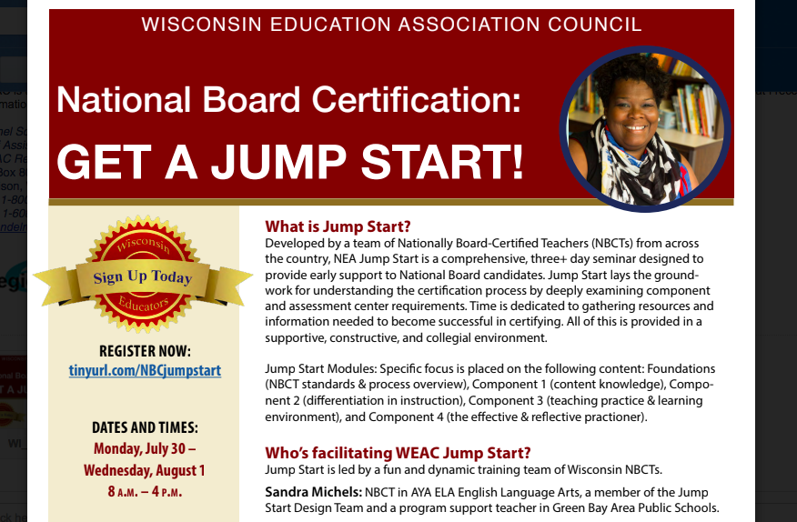
Notes:
One of WEAC’s support is Jump Start. This year’s Jump Start was cancelled due to COVID-19. We are talking with other networks and considering doing a virtual Jump Start.
Currently, the national board has many wonderful recordings and resources available to you, and I pointed out some of those on the COVID-19 resources page of the National Board website. There truly has never been more response to the certification process than what there has been from the NB staff during COVID-19!

Slide 31
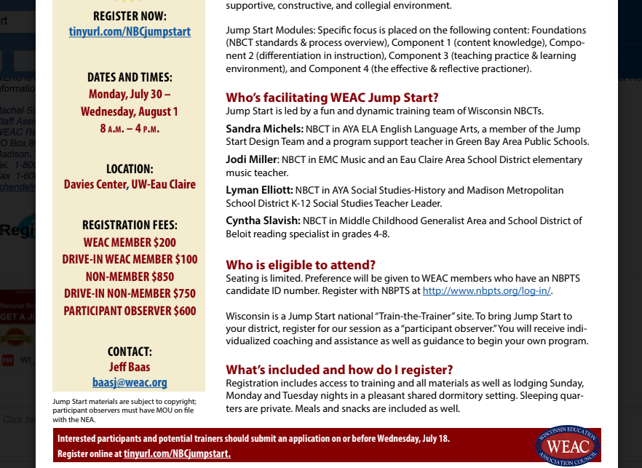
Notes:
This slide offers the logistics about the three day training and start to certification that is available to you with WEAC’s support. Hopefully, we will be able to hold this training next summer in person! Currently there are cohorts that are working virtually throughout the state and throughout the school year. Maybe this spring we will be able to hold our Dare to Think Writing Retreat in person. It was the last event we held prior to the March 13 end of school!

Slide 32

Cyntha Slavish
cslavish@gmail.com
608-302-5682
Notes:
I truly hope you consider the National Board Certification journey. There are fantastic people to support you along the way! Let’s show everyone that we too are a group of accomplished people who want the very best for our students and are able to work together collectively to advance the dignity of our profession! One of the taglines of the NB is, “The sum is greater than the parts.”
(Slide link is to Candidate Resource center--First Time and Returning Candidates is your place to begin!)

Slide 33

Cyntha Slavish, NBCT
cslavish@gmail.com
608-302-5682
Notes:
Please contact me if you have any questions at all!
This is very nice, but there’s no need to thank me :) Thank you to Jeff Baas and his team for their dedication to the professional development of all WEAC members! He truly makes this support happen, and he and his team do amazing things like the coordination of mentors with candidates, support the annual statewide Dare to Think Writing Retreat. Jeff’s team arranges travel (when we could travel) to NEA’s National Board events.
Jeff is an advocate for NB through WEAC and the NEA.
Please contact me if you would like further information or you have questions or want me to connect you with an NBCT in your certificate area to ask specific questions.
Thank you again for your curiosity.
I hope this is just your first step on your NB journey.

